Slide 1


Shoot for the Stars
Milestone 2
Stellarverse Studio

Slide 2

On the Team
Ava Hornback
Character Art, Animation
Rae Fu
3D Artist and Tech Artist
Anastasia Hinton
Renee Bauer
Audio, UX, Producer, Programming
Level Design, Concept Art, Character Art, 3D Modeling
Ethan Baxter
Programming and Integration

Slide 3
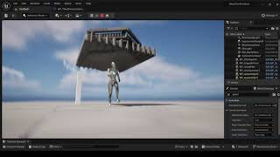
Programming

Slide 4
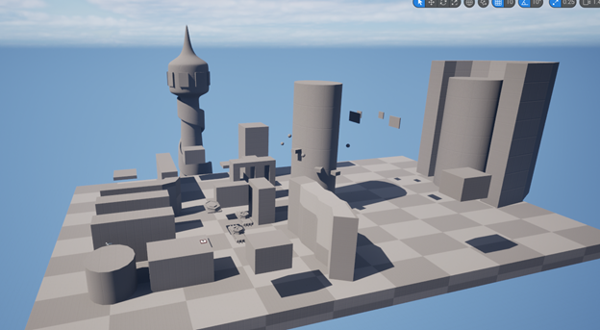
Whitebox

Slide 5
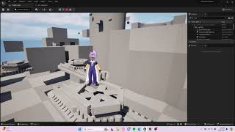
Character in whitebox

Slide 6
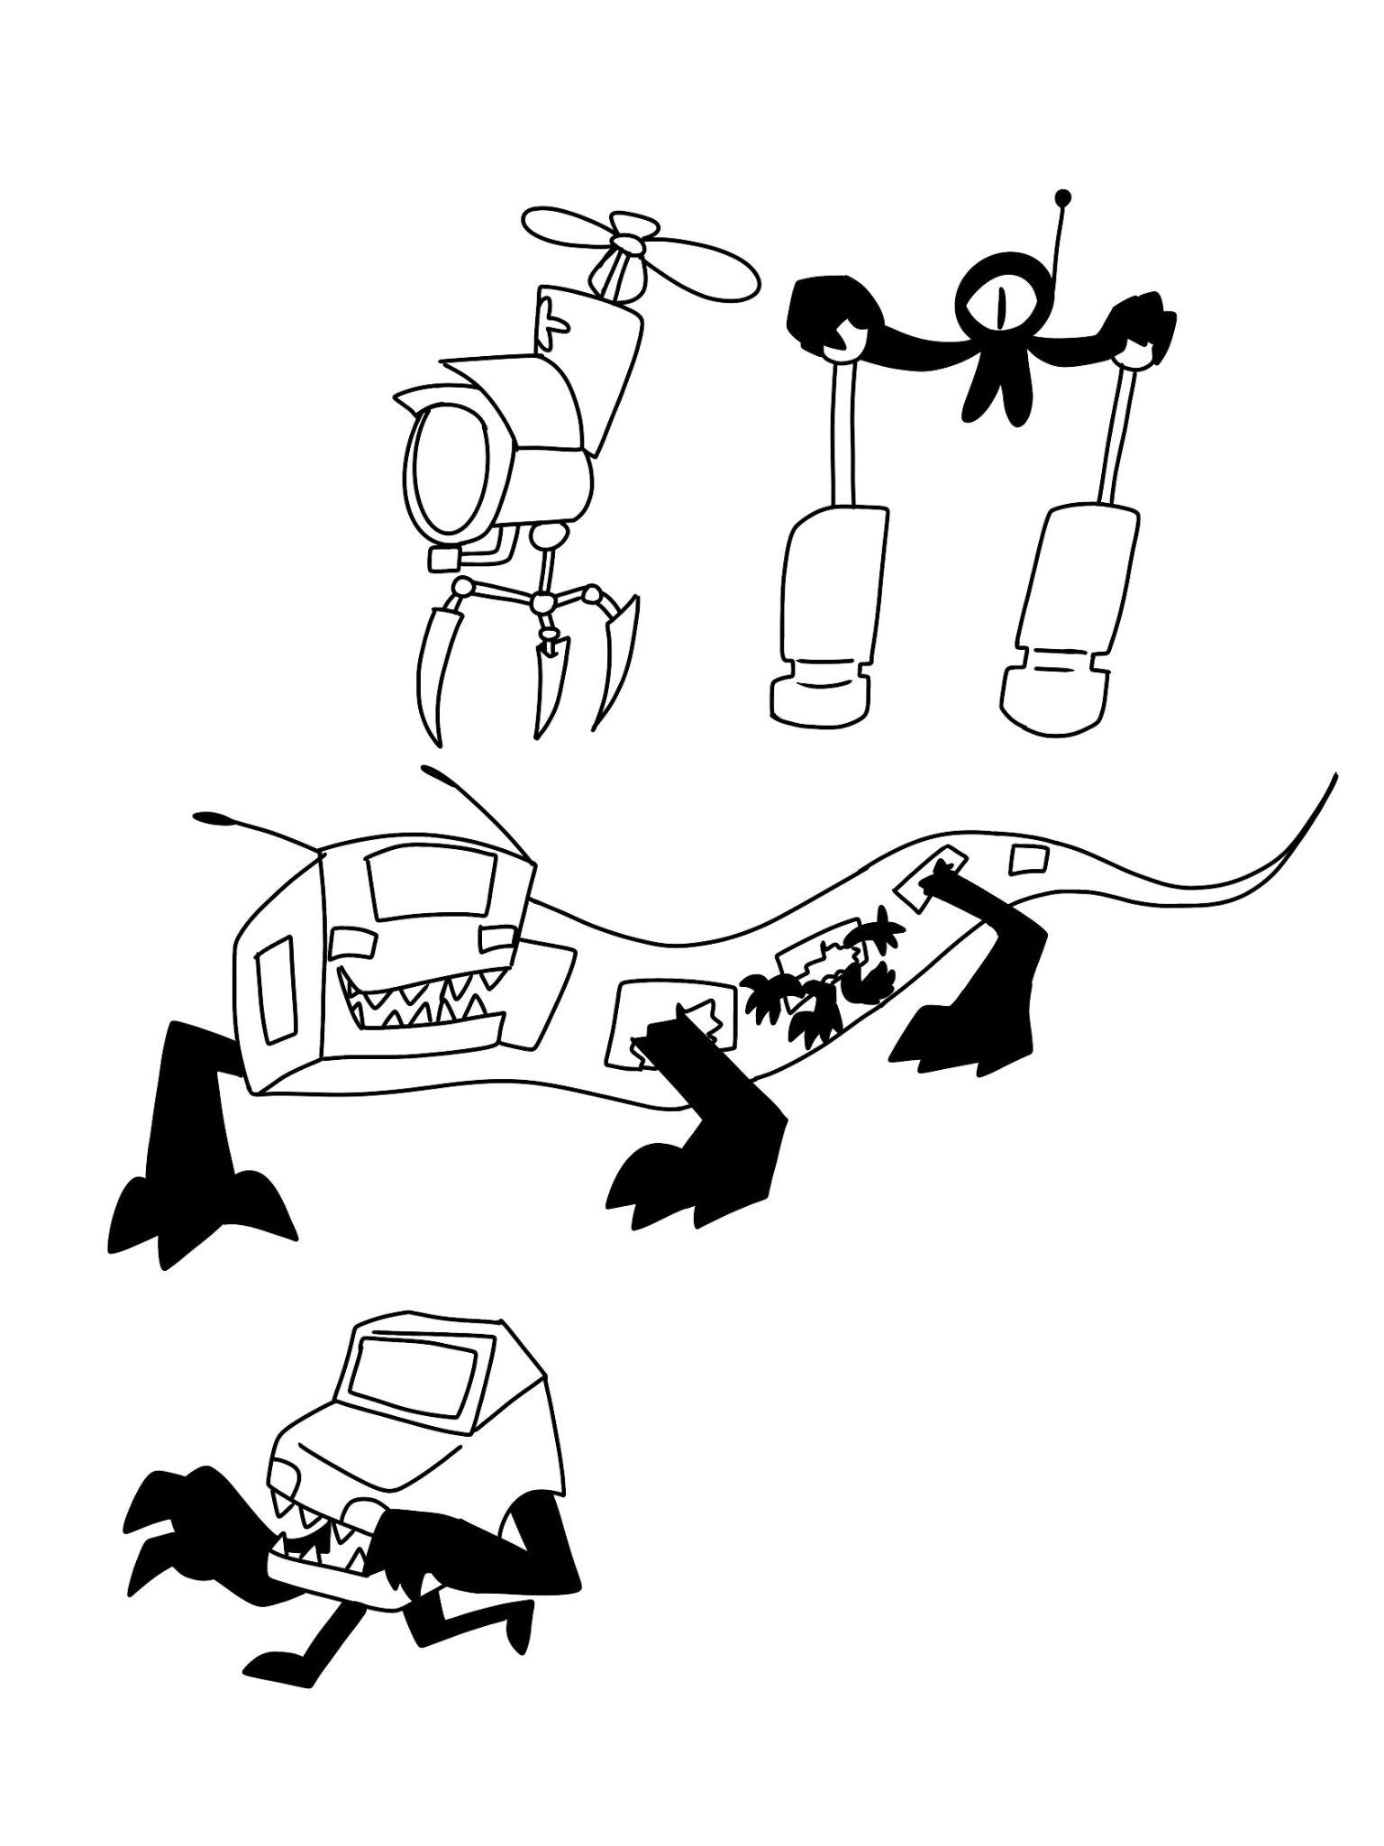
Enemy Concepts

Slide 7
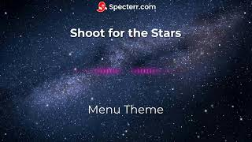
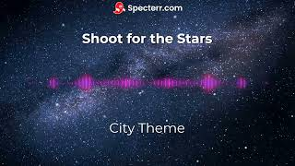
Music

Slide 8

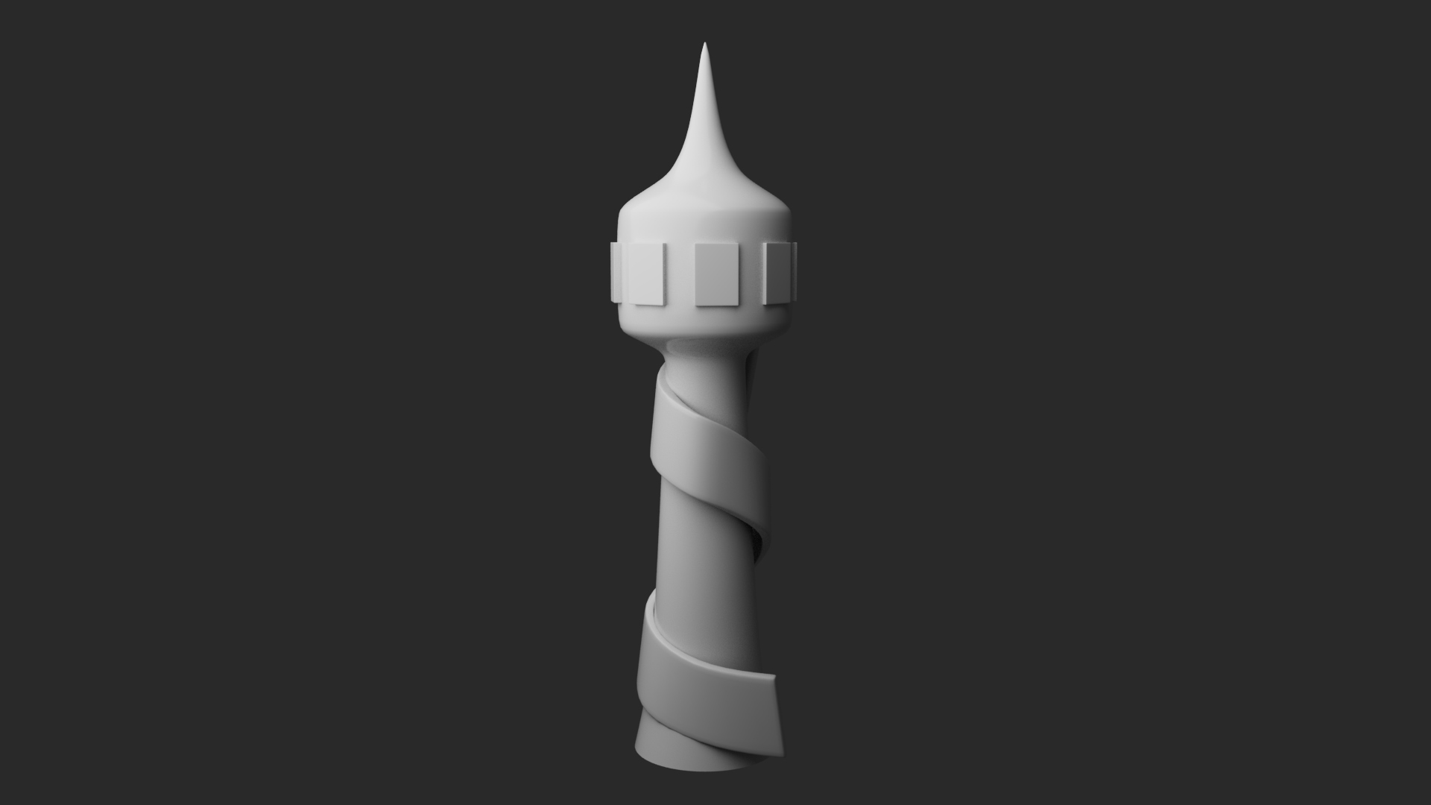
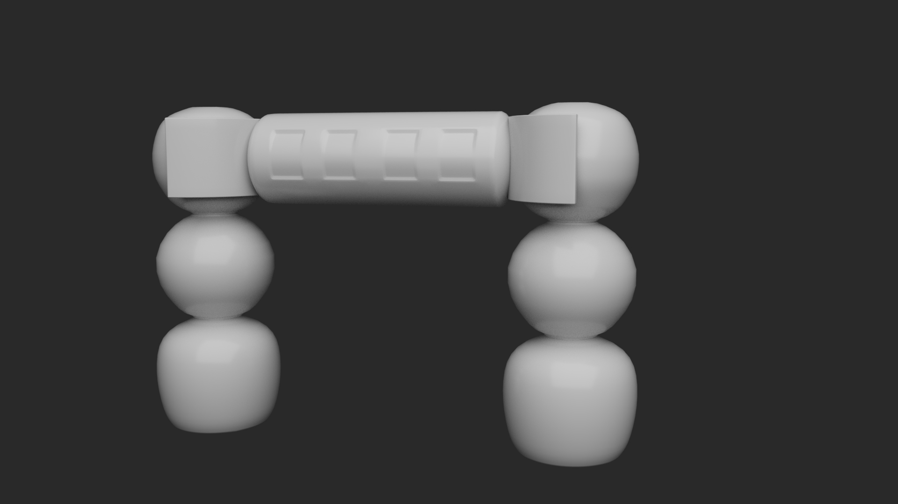
Building Models

Slide 9
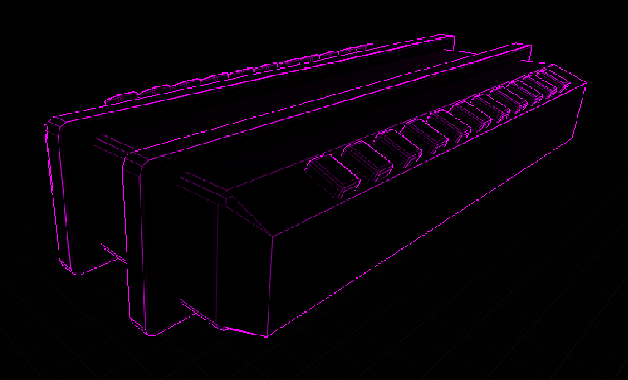
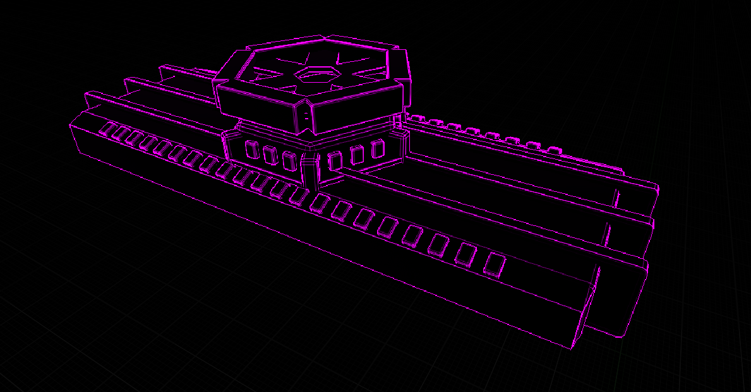
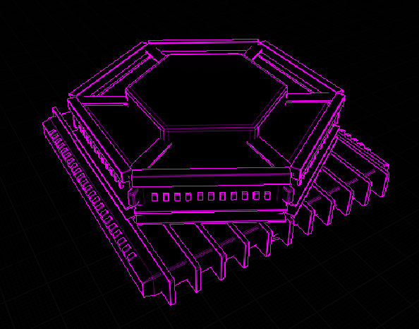
Spaceships

Slide 10
Milestone Update
What have we completed?
A whitebox of the first level
Character art
Spaceship models
Some of the building models
Some programming focused assets
What do we still have to do?
Finish the first level
Title page/Menu
Remaining programming focused assets

Slide 11
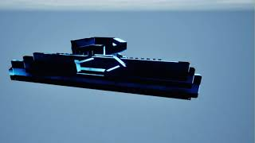
Plans for next Milestone
Add enemies
Finalize grappling hook
First level art pass
Finalize camera and movement
Complete rest of the building models
Add a few visual effects
Finalize art style

Slide 12
THANK YOU!

